Slide 1
Adventure Works | 2004
SALES ANALYSIS

Slide 2

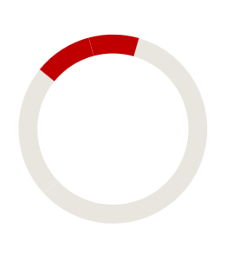

2004 to date ( Data Until September )
40.7%
137.5%
12.1%
16.5%
32.2M
-13.93M
13.95K
23.7K | 828
SALES
PROFIT
ORDERS
AVG. ORDER VALUE
OFFLINE | ONLINE

Slide 3
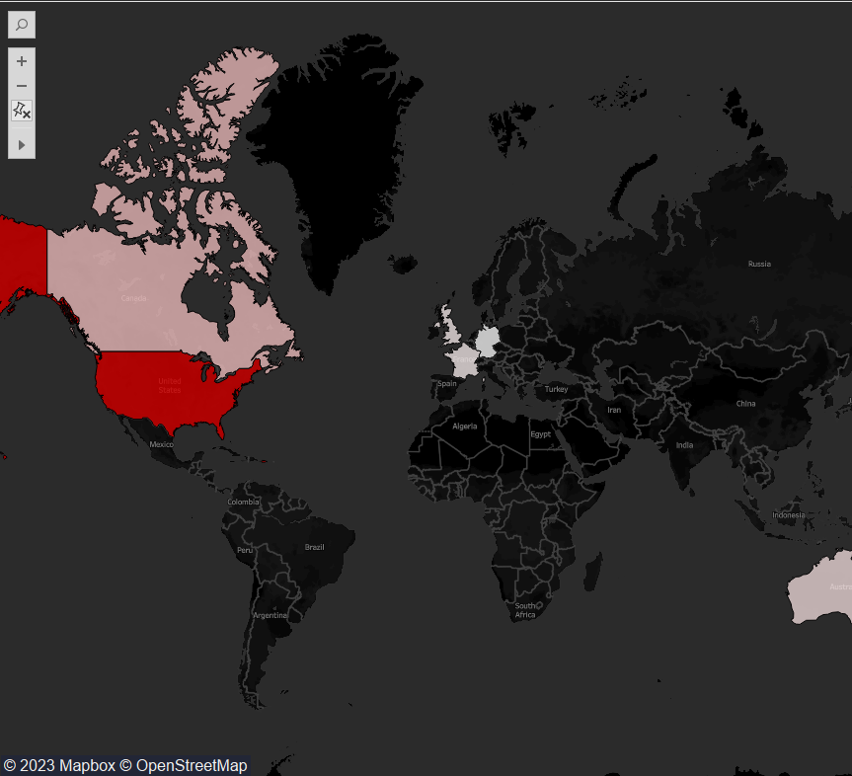
Sales by country
US is the main customer & significantly exceeds other countries throughout any time period.
Australia and European countries are relatively small customers, but together they still represent large amount of revenue.
Country | 2004 | 2003
US | 16.16M | 30.12M
Canada | 3.93M | 8.17M
Australia | 3.82M | 4.55M
UK | 3.04M | 4.37M
France | 2.85M | 4.37M
Germany | 2.39 | 2.71M

Slide 4
subCategories
Categories
Road, Mountain & Touring bikes are our top 3 subcategories
Frames of all types are next best-sellers
Subcategory, and even category sales patterns are similar each year.
87%
<5%
Of total revenue accounted by Bikes
Of revenue accounted by Clothes & Accessories together

Slide 5
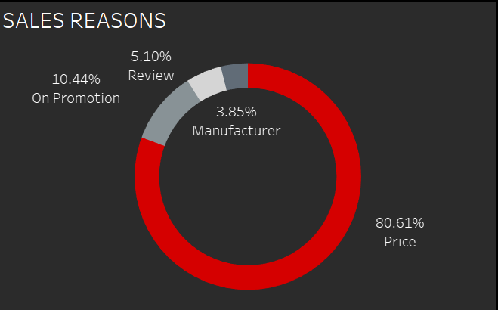
Price is main sales reason, and grew from 60% to 80% of total sales from 2003 to 2004.
Promotion (may also be attributed to price) decreased from a quarter to one-tenth of all sales.
Review shrank by half, while Manufacturer doubled throughout the year.
In the beginning, 2001, Manufacturer represented 100% of revenue, and 67% in 2002, but price quickly took over

Slide 6
8.46%
Customer churn rate
Below 10% churn rate shows high loyalty of our customers.
Churn = no order within 365 days

Slide 7
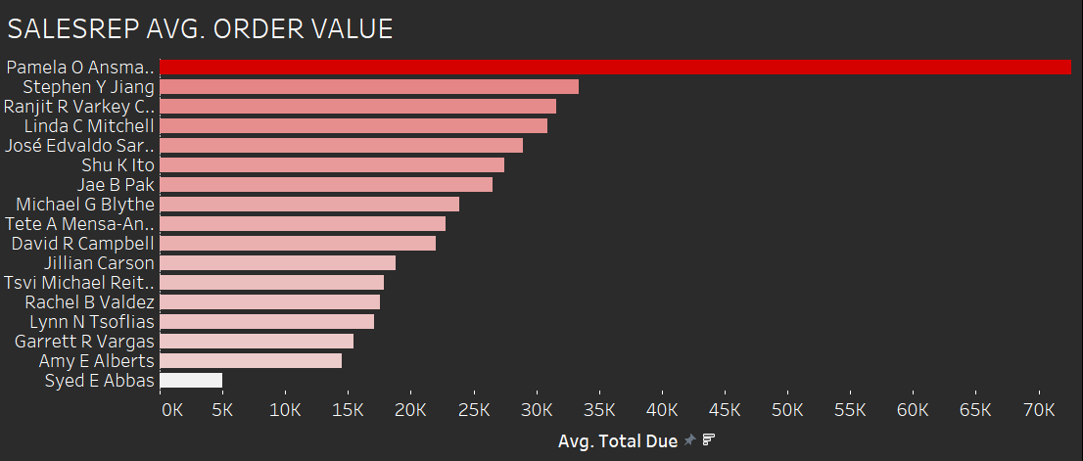
$40K
Difference between 2 top salesreps’ average
Pamela O Ansman significantly outperforms others
‘Stairway’ graph shows salesreps use different strategies and have different levels of experience in deal-making.
Salespersons work in different regions, thus small differences would be normal.

Slide 8
Solutions
GROW IN EUROPE
MAINTAIN COMPETITIVE PRICING
RE-EVALUATE SMALL CATEGORIES
Look for possibilities of expanding in other countries
Are clothes and accessories profitable?
Especially for bikes and frames, our top sellers
INTRODUCE LOYALTY PROGRAMME
INVEST IN SALESREPS
To maintain loyalty of online consumers
Provide learning courses. Examine Pamela O Ansman’s methods and teach others

Slide 9
Thank you.

